Slide 1


WEALTHWIZARD
WealthWizard
A Streamlit Console for Snowflake-Native Personal Finance
Cloud Data Pipeline · Gemini-Powered Insights · One Streamlit App
4
78K+
6
Snowflake schemas
transactions processed
pages, one Streamlit app
Team WealthWizard · Capstone Project

Slide 2





THE PROBLEM
Personal finance data is everywhere—and nowhere useful
OUR VISION
Scattered records
One clean pipeline. One trustworthy number.
Transactions live across banks, wallets, and receipts with no single source of truth.
No real-time visibility
People discover they're over budget after the money is already spent.
WealthWizard ingests raw transactions from multiple file formats, validates and cleans every record, models it for fast analytics, and surfaces AI-generated insights—through a Streamlit console that answers "how am I doing?" in seconds, not spreadsheets.
Manual categorization
Sorting expenses by hand is tedious, so it rarely gets done consistently.
Raw file → Validated → Modeled → Insight → Decision
WealthWizard · Project Overview 02

Slide 3










SYSTEM ARCHITECTURE
From raw files to a Streamlit console
S3 + Snowpipe
RAW
STAGE
MART
ANALYTICS
Streamlit App
Ingestion
Landing zone
Validated
Star schema
Views + AI
st.connection
CSV / NDJSON / TXT files land automatically
No constraints — accepts dirty data as-is
Validated, deduped, rejects logged separately
DIM_* / FACT_* tables, surrogate keys
Monthly summaries, anomaly detection, Gemini insights
Python reads MART / ANALYTICS directly
Governed end-to-end by a single least-privilege role (WEALTHWIZARD_ETL) and orchestrated by Snowflake Streams + Tasks.
WealthWizard · Architecture 03

Slide 4







DATABASE · INGESTION
Multi-format ingestion, fully automated
Amazon S3
Entity-first folders (user/, transaction/, budget/…), date-partitioned
Storage Integration
Design principle: raw = faithful copy
IAM-scoped connection — Snowflake never sees AWS credentials
Real-world raw data is messy — negative amounts, mixed date formats, missing IDs. Rather than reject it at the door, RAW tables store every column as nullable text with a generated surrogate row key. Nothing is lost; everything is captured for the Stage layer to validate.
Snowpipe
7 auto-ingesting pipes, one per entity/format — event-driven via SQS
RAW tables
Zero constraints by design: every value is nullable text, so nothing gets silently rejected
WealthWizard · Database Pipeline 04

Slide 5

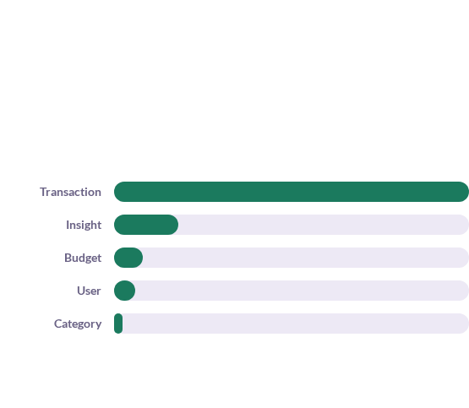

DATABASE · STAGE LAYER
Every row is validated — nothing disappears silently
Type & format
Dates parsed across 5 formats, currency strings stripped to decimals
Raw → Stage reconciliation
Business rules
Negative amounts rejected, future-dated transactions rejected
Referential integrity
Orphan user_id / category_id caught before reaching Stage
Deduplication
Tie-broken so a valid row can never lose to a blank one
Every rejected row is logged with a specific reason — never silently dropped.
WealthWizard · Database Pipeline 05

Slide 6






DATABASE · MART LAYER
A star schema built for fast dashboard queries
FACT_TRANSACTION
78,155 rows
FACT_BUDGET
6,170 rows
Why surrogate keys?
Track history without overwriting past facts
FACT_INSIGHT
Decouple mart from source-system key formats
23,956 rows
Faster joins across every fact table
A clean "unknown" row for orphaned references
WealthWizard · Database Pipeline 06

Slide 7
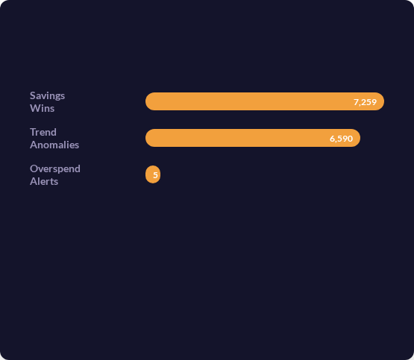


DATABASE · ANALYTICS LAYER
From numbers to narratives
GEMINI-GENERATED INSIGHTS — ONE PRODUCTION RUN
Monthly Spend Summary
Income, expense & net savings per user per month
Category Ranking
Top spending categories, ranked, per period
Spending Anomaly
Flags spend > 1.5× a category's 6-month trailing average
Savings Opportunity
Flags spend < 70% of trailing average — the good news, too
WealthWizard · Database Pipeline 07

Slide 8




DATABASE · BUSINESS LOGIC
The pipeline doesn't just clean data — it acts on it
Category Reassignment
Budget Alerts
When a category is deactivated, its transactions don't become orphans. A guarded procedure automatically reassigns them to Uncategorized and logs the change — every reassignment is traceable.
Budgets are recalculated against real spend and classified ok / over. Alerts refresh automatically, non-blocking — they inform the member without stopping a transaction.
WealthWizard · Database Pipeline 08

Slide 9




DATABASE · AUTOMATION
Streams + Tasks: Snowflake's event-driven engine
STREAM
"What changed since I last looked?" — a passive, always-on change-data-capture pointer on every table.
TASK
Runs on a schedule but skips execution entirely when its stream is empty — zero compute cost while idle.
Every stage of the pipeline chains automatically — Raw clean → Mart load → Alerts → Insights — no manual trigger required.
SYSTEM$STREAM_HAS_DATA() gates every task — an empty stream means zero credits spent.
WealthWizard · Automation 09

Slide 10





DATABASE · GOVERNANCE
One role, least privilege, full traceability
RAW_WEALTH_WIZARD
Landing zone — locked down, no downstream access
WEALTHWIZARD_ETL
STAGE_WEALTH_WIZARD
Validated data — pipeline-only access
One dedicated role owns every pipeline object — tables, views, streams, tasks, pipes, and stages — instead of ad-hoc admin access.
MART_WEALTH_WIZARD
Star schema — read access for the Streamlit app
SELECT / INSERT / UPDATE on future tables
USAGE on every schema, explicitly
ANALYTICS_WEALTH_WIZARD
OPERATE + MONITOR on all pipes
Views & AI grounding — dashboard-facing
EXECUTE TASK at account level
WealthWizard · Database Pipeline 10

Slide 11








APPLICATION · ARCHITECTURE
One Python process — no separate backend to secure
Browser
Streamlit Process
Snowflake
Renders the Streamlit UI
streamlit_app.py · session state · cached queries
MART / ANALYTICS via st.connection
Gemini API
st.connection("snowflake") holds one connection for the whole session — nothing else to configure.
data.py wraps every query in @st.cache_data(ttl=600s), one function per screen, bound parameters only.
Signed-in member, selected month, and appearance mode all live in st.session_state, read once and shared across every page.
ask.py calls the Gemini API directly with urllib, from inside this same process — the key never reaches the browser.
WealthWizard · Architecture 11

Slide 12












DASHBOARD · PAGE TOUR
Six pages, one signed-in member's record
Overview
Transactions
Categories
Lifetime total, this month's cards, category split, and a monthly trend on one screen.
The full ledger — filter by category, search descriptions, switch scope to the active month.
Lifetime vs. a single month, side by side, with a lifetime-share column for spotting spikes.
Budgets
Insights
Ask
Every envelope, limit vs. recomputed spend, with alerts raised when one was breached.
What the mart flagged — filterable by kind and severity, downloadable as CSV.
A Gemini-backed analyst that decides whether a question needs the member's own rows.
WealthWizard · Dashboard 12

Slide 13








DASHBOARD · DESIGN LANGUAGE
Banknote colour, and a split-flap board for the numbers
The signature: split-flap totals
A palette drawn from Indian banknotes
Every hero total renders as individual tiles — styled and animated like an airport departure board — that flip into place on load. Digits get the flap treatment; separators and punctuation render as quiet, static tiles beside them.
The app counts in rupees, so its colours come from the notes themselves — enough distinct hues for a twenty-slice category ring without inventing any.
₹200 · Saffron
#F2A03D
₹100 · Lavender
#A78BD0
Cr · headline figure, mid-flip
₹50 · Cyan
#35A7C2
₹2000 · Magenta
#E8637F
Positive · Green
#46B08D
WealthWizard · Dashboard 13
Every colour is a CSS variable, swapped in one function for the light/dark toggle — no component ever names a hue directly.

Slide 14



DASHBOARD · OVERVIEW PAGE
A member's whole record, one month at a time
The hero
TOTAL MONEY ON YOUR RECORD
₹3.73 Cr
Lifetime total on record, flanked by exact / average / largest transaction figures.
Month cards
This month's spend vs. last month, transaction count, average ticket, categories used, share of lifetime total.
Where it went
A donut of this month's category split, with a legend ranking every category by share.
Your months
A bar chart of up to 18 months of history, with the selected month lit in saffron.
Largest this month
Category split · monthly trend, mocked
The ten biggest transactions, ranked, each with an inline bar against the largest.
WealthWizard · Dashboard 14

Slide 15






DASHBOARD · BUDGETS & INSIGHTS
Limits that recompute themselves, and a mart that flags what matters
Budgets
Insights
3,278 of 4,434 accounts carry at least one envelope.
23,956 rows on the mart — filterable by kind and severity, exportable as CSV.
Groceries82%
13,854
10,102
Travel108%
generated in the mart — graded, severity 2–5
loaded from staging — shown as "ungraded," never hidden
Utilities55%
Dining out94%
Each row shows its kind, a severity chip, what it says, and when it was raised — sorted most severe first.
Utilisation is recomputed from real transactions — stored ACTUAL_SPEND is 0 on 6,163 of 6,170 rows, so it is shown for reference only.
5 budget alerts on record — every one raised at 'over', no warning tier exists.
WealthWizard · Dashboard 15

Slide 16






DASHBOARD · AI INTEGRATION
"Ask WealthWizard" — grounded, not guessing
Member asks a question
"How's my Travel spend this month?" — typed, or picked from an opener
The Gemini key never reaches the browser
Gemini decides the shape
The key comes from a Snowflake secret or config.py, and the call happens with urllib from inside the same Streamlit process that renders the page — there is no separate service to deploy or secure.
General knowledge answers directly; a data question returns one proposed SQL statement
The app guards and runs it
One read-only SELECT, fully qualified, scoped to this member — one retry if it fails
Every generated SELECT is checked for a single statement, no write keywords, and a filter on this member's own USER_ID before it is allowed to run.
Gemini writes the answer
Rows go back to Gemini for 2–4 plain sentences in rupees; the SQL is shown in an expander
"Groceries are at ₹9,800 against a ₹12,000 budget this month — 82% used, comfortably on track."
WealthWizard · Dashboard 16

Slide 17
ENGINEERING RIGOR
Known data conditions, handled transparently
The mart is not perfectly clean — the app names each limitation and works around it in the open, rather than hiding it.
Budget spend stored as 0 | 6,163 of 6,170 FACT_BUDGET rows carry ACTUAL_SPEND = 0 | Recomputed live from FACT_TRANSACTION on every load
Budget period unreliable | Only 501 of 6,170 rows match DIM_DATE; bad periods fall back to 1970-01-01 | Year and month derived arithmetically from the stored key instead
Insight severity missing at scale | 10,102 of 23,956 insights carry no severity — the rows loaded from staging | Shown as "ungraded" in its own filter, never hidden or guessed at
Expense-only ledger | TXN_TYPE is 'expense' on all 78,155 rows — there is no income or savings figure | The assistant is instructed never to imply a savings rate exists
Sign-in identifies, not authenticates | Any valid member id opens that account — there is no password | The interface says so plainly, right on the sign-in screen
WealthWizard · Database Pipeline 17

Slide 18





UNDER THE HOOD
The full technology stack
Cloud Data Platform
Streamlit Application
Design System
Snowflake (RAW/STAGE/MART/ANALYTICS)
Python + Streamlit, one process
Custom CSS theme, tokens as variables
st.connection("snowflake") + st.cache_data
Split-flap board for headline totals
Streams, Tasks, Snowpipe
Google Gemini API, called server-side
Light / dark mode, swapped at runtime
Amazon S3 + Storage Integration
WealthWizard · Technology 18

Slide 19






WHAT'S NEXT
Where WealthWizard goes from here
Real member authentication
Source-level data quality fixes
Broader assistant tool use
Cross-account resilience
Replace the id-only gate with a password or SSO check — today, any valid id opens the account
Extend the guarded SQL layer to comparisons across months and simple forecasts
Evaluate Snowflake replication for disaster recovery
Correct FACT_BUDGET.ACTUAL_SPEND and PERIOD_DATE_KEY at the mart layer, not just in the app
WealthWizard · Roadmap 19

Slide 20


Thank You
WealthWizard — questions welcome
Team WealthWizard

